Slide 1

Elden Deguia, Mathew Biji, Hudson Duong, Tanzeel Jaffery, Timothy Mathew, Vidur Nangia, Dylan Tirandez

Slide 2
Objective
HealthMatch is a comprehensive, management-facing application that allows businesses to
correctly choose healthcare providers for their employees using relevant data. HealthMatch will
collect data on employee’s needs as well as management’s cost restraints to find an ideal
healthcare provider match that meets all parties’ needs. Through usable design and efficient
software, HealthMatch will make the task of choosing healthcare providers easier than ever
before.

Slide 3
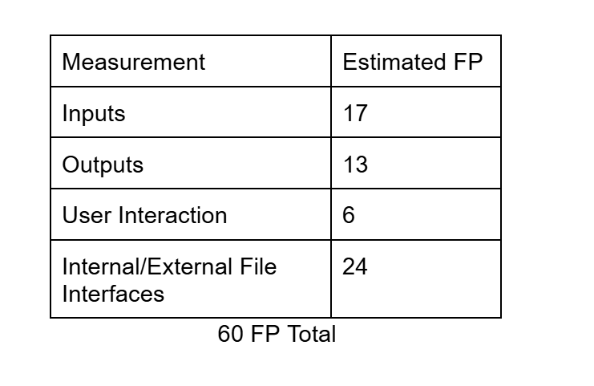
Cost Estimation
Estimation Method Used
Used the Function Point (FP) method.
FP measures software size by counting:
Inputs (data entering the system)
Outputs (reports, results)
Data files (actual database management)
User interactions (inputting employee/company data)
These metrics fit better for our system as opposed to application composition, which is more UI centric.
HealthMatch totals ≈ 60 Function Points (based on its inputs, outputs, and data complexity).
Organization Rate: 10 FP ≈ 1 person-month
Required effort: 60 / 10 ≈ 6 person-months

Slide 4
Cost Estimation
Labor Cost (FP Method)
Estimated Size: 60 FP
Productivity Rate: 10 FP ≈ 1 PM
Required Effort: 6 person-months
Developer Rate: $9,000 / month
Labor Cost = $54,000
Personnel Cost Summary
Total Personnel Cost: $54,000
Costs of labor will go towards the development of:
Various inputs from administrators, managers
Data storage + dashboard
Recommendation engine
Authentication/security

Slide 5
Cost Estimation
Hardware Cost: ~$450
Covers cloud server + storage needed to host and develop HealthMatch
No physical machines required since everything can run online
Software Cost: ~$270
Mainly from managed database + analytics tools
The software itself is planned to be developed using open-source, free software
Most development tools (GitHub, VS Code, IntelliJ CE) are free
Labor Cost: $54,000
Based on the FP estimate of 6 person-months
Includes development, testing, and iteration time
Total Estimated Project Cost:
$54,730
Quoted Price (+25% markup):
≈ $68,412 (Represents a realistic client-facing price including profit plus the overhead)

Slide 6
Project Timeline
6-month Project Timeline (following the layered architecture)
The system shall be built according to an agile process model
January 15, 2026 - July 30th, 2026
Data Layer (6 weeks | Jan 15 - Feb 26): design schemas, databases, and data modeling
App Services Layer (12 weeks | Feb 12 - May 7): Partially concurrent, data normalization, build CRUD operations, developing and testing.
Configuration Layer (10 weeks | Mar 12 - May 21): Partially concurrent, authentication and security
Presentation Layer (10 weeks | April 9 - Jun 18): Partially concurrent, front-end layers, dashboard, manager/comparison view
Product Readiness (6 weeks | Jun 18 - Jul 30): Readying and integrating all aspects of the product, final discussions with stakeholders, building necessary advertisers etc.

Slide 7
Project Timeline - Justification
Length: January 16 - July 30th
  Standard timeline for complete and dedicated cross-functional group
  Enough time to meet MVP
  Concurrent development allows for fast approach
Work details:
  No weekends
  Standard 8 hours/day 5 days/week

Slide 8
Functional Requirements
The company manager shall be enabled to upload, insert, and update company and employee data.
The system shall enable the employee administrator to request and see the list of recommended healthcare plans.
The system shall enable a Manager to produce reports based on matches provided by the system
The system shall ensure a session and permissions are verified before and request is made by a user to access or modify any data

Slide 9
Non-Functional Requirements
The recommendation engine shall take inputs and present recommendations within 15 seconds of request
The system shall have a 99.5% uptime during regular working hours
The system shall be in accordance with all provisions of the HIPAA with regard to privacy and security of patient information
The application shall be a web-based system that fully works on Google Chrome, Mozilla Firefox, Microsoft Edge, etc.

Slide 10
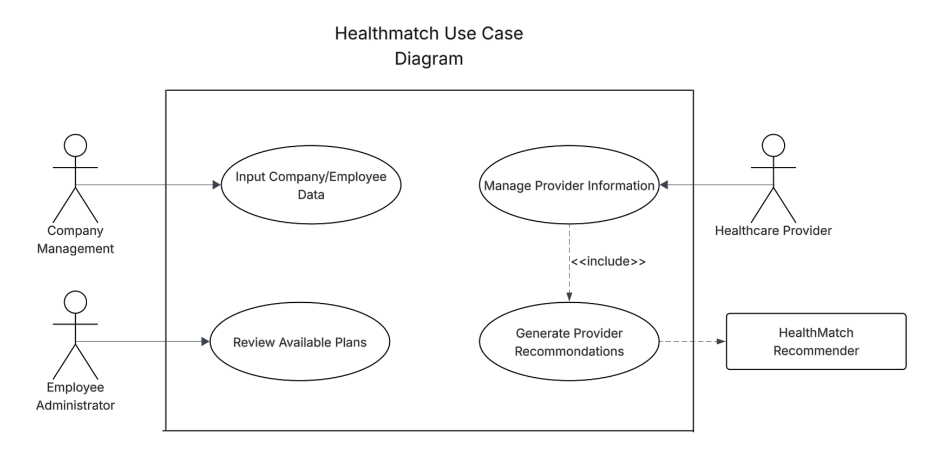
Use Case Diagram

Slide 11
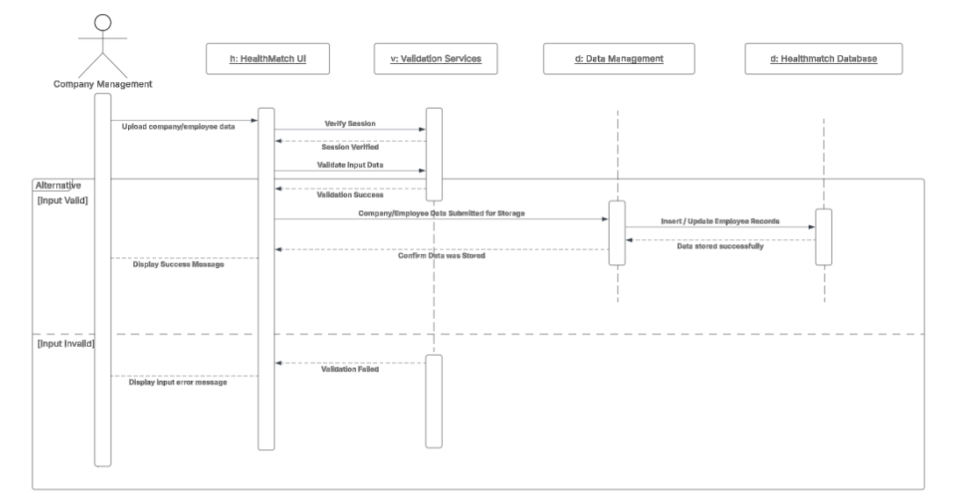
Sequence Diagram for Input Company/Employee Data Use Case

Slide 12
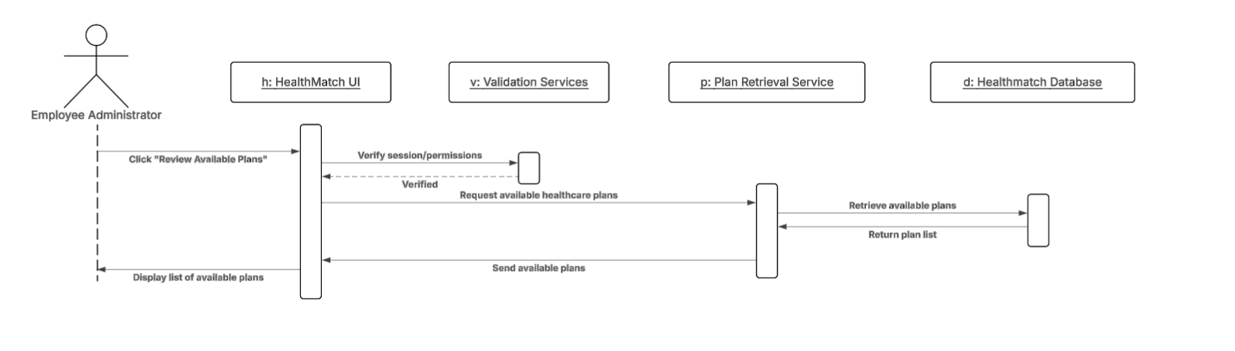
Sequence Diagram for Reviewing Available Plans

Slide 13
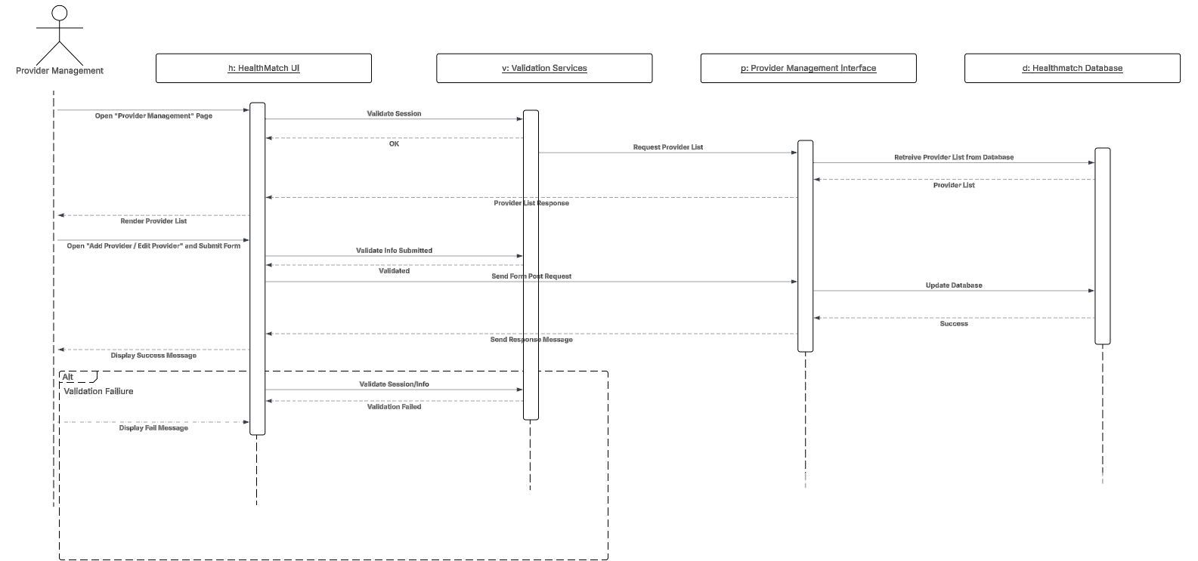
Sequence Diagram for Managing Provider Information

Slide 14
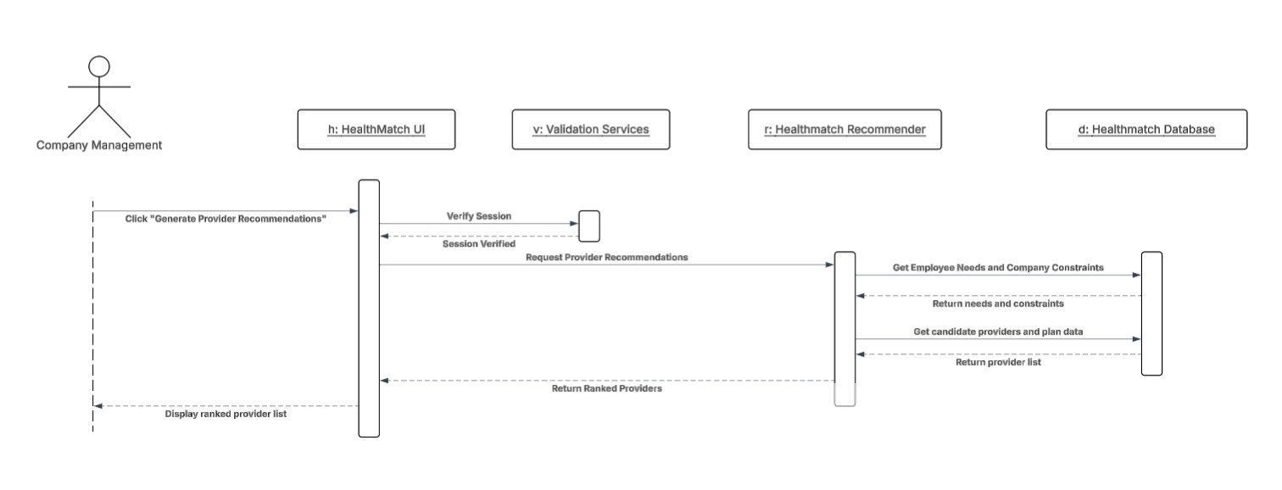
Sequence Diagram for Generating Provider Recommendations

Slide 15
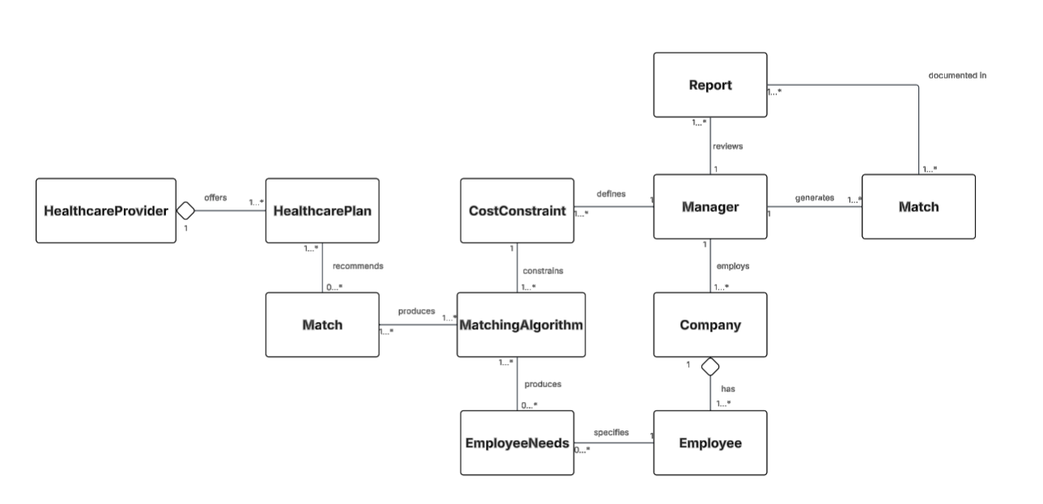
Class Diagram

Slide 16
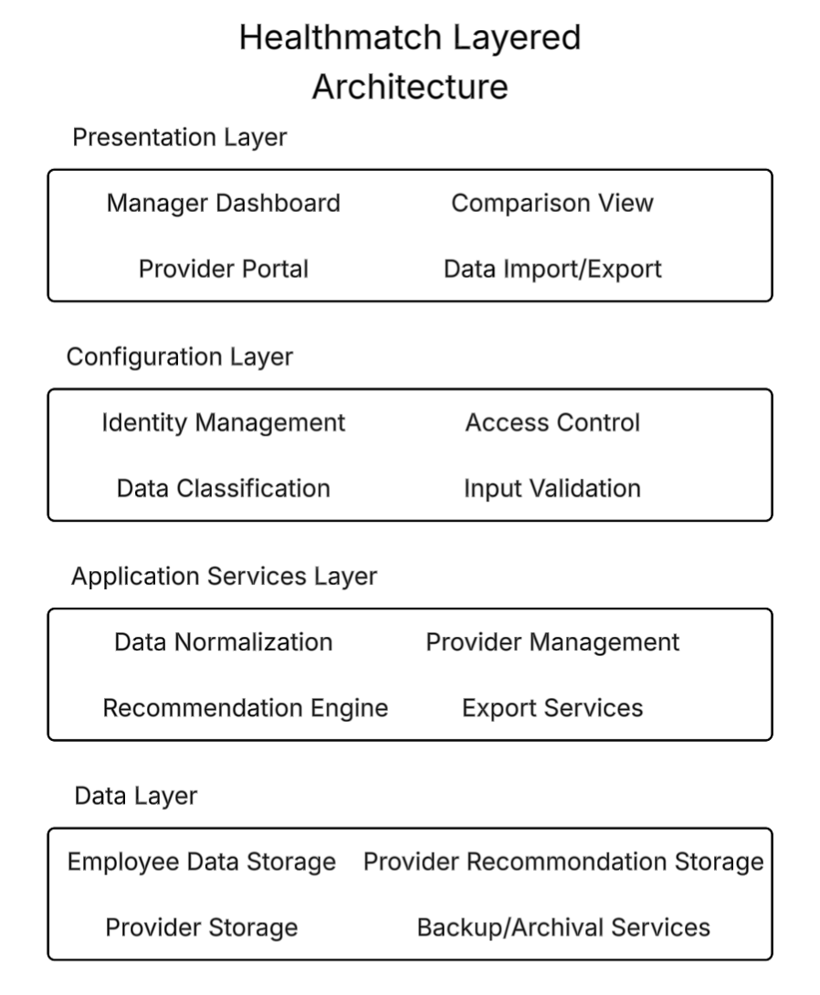
Architectural Design Diagram

